Slide 1
Module 13
Distribution Decisions -
Logistics & Channel Management
By: Dr Shahinaz Abdellatif

Slide 2
Objective of this session
1. To examine the channel design and channel management decisions a marketer faces

Slide 3
Channel Design
Channel design decisions concerned with developing a channel structure that links the firm’s marketing strategy with the needs of its target market.
These decisions focus on questions such as how many levels of middlemen should be included in the distribution system and what types of institutions, and how many of each, should be included at each level.

Slide 4
Channel Design
Channel management decisions involve the development of policies and procedures to gain and maintain the cooperation of – and often to form mutually beneficial long-term relationships with – the various institutions within the channel. Such decisions focus on selecting and recruiting individual channel members, motivating them to perform specific marketing functions on behalf of the supplier’s product or service, coordinating their efforts, assessing their performance, and resolving conflicts that arise.

Slide 5
Marketing Channel
Marketing Channel is the set of interdependent organisations involved in the process of making product or service available for consumption or use by consumers or industrial users.
The rationale for marketing channels lies in the trade-off between costs and benefits.

Slide 6
Ways by which middlemen increase efficiency
Functional efficiency: Middlemen can often perform one or more marketing activities more efficiently than manufacturers or their customers because of their specialisation and greater economies of scale.
Scale efficiency: By purchasing goods in large quantities, storing them and then breaking them down into the smaller quantities their customers prefer, middlemen enable manufacturers and their customers to operate more efficiently. Rather than having to make small production runs to fill the orders of individual customers, manufacturers can achieve the economies of large-scale production. Transactional efficiency: Through their various activities, wholesalers and retailers make it possible for customers to acquire wide assortments of products from a single source which reduces the time and effort .

Slide 7
Channel Design
Channel design options: sell direct or through some channel?
  Retailer
  Wholesaler
  Agent
  Combination thereof
How to decide among the types of channels?
Consider the channel objectives (see next slide) and rate the channel structure against each one. Then balance the trade-offs and the company’s resources.

Slide 8
Step (1) Objectives for Channel Design
Decisions
Product availability
Meet customer service requirements
Win promotional support
Obtain market information
Cost effectiveness
Flexibility
Notes:
Deciding among these competing objectives always involves tradeoffs.

Slide 9
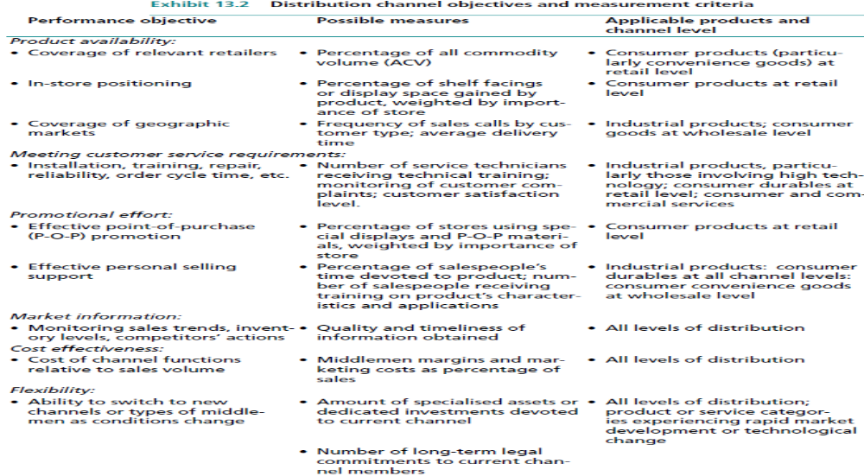

Slide 10
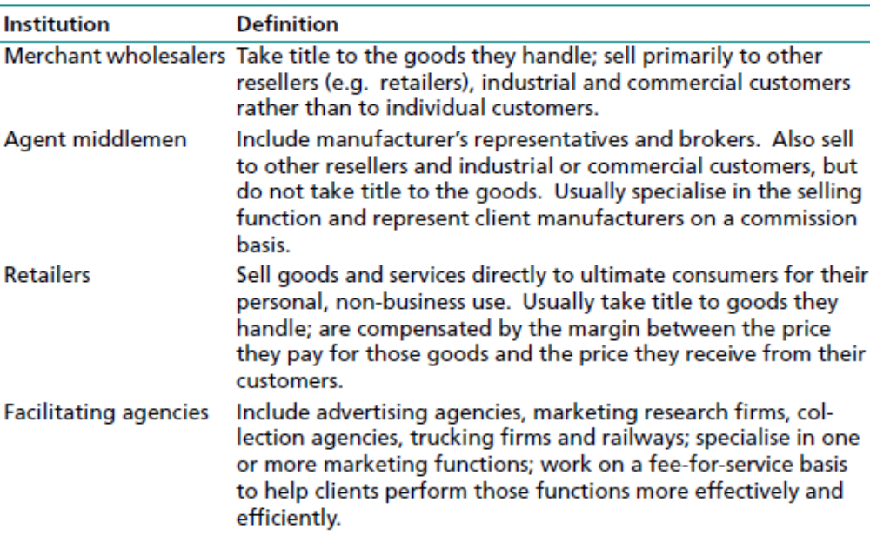
Types of Middlemen

Slide 11
Channel Design Options for a
Consumer Product
A
B
C
D
E
Producer
Producer
Producer
Producer
Producer
Agents
Agents
Wholesaler
Wholesaler
Retailer
Retailer
Retailer
Retailer
Consumer
Consumer
Consumer
Consumer
Consumer
Notes:
Channel design options: sell direct or through some channel?
Retailer
Wholesaler
Agent
Combination thereof
How to decide?
Consider the channel objectives (see next slide) and rate the channel structure against each one. Then balance the trade-offs and the company’s resources.

Slide 12
Channel design options for industrial goods and services
A
B
C
D
Producer
Producer
Producer
Producer
Agent
Agent
Wholesaler
Wholesaler
Industrial Buyer
Industrial Buyer
Industrial Buyer
Industrial Buyer
Notes:
3
Channel design options: sell direct or through some channel?
Wholesaler
Agent
Combination thereof

Slide 13
Hybrid Channel Design
A hybrid channel design can spread the necessary tasks across several players

Slide 14
Example of a Hybrid Marketing Channel
A hybrid channel design can spread the necessary tasks across several players
Company Website
& Sales Force
Demand Generation
Wholesale
Distributor
Physical
Distribution
Supplier
Customer
Company
Help Line &
Outside
Service Centers
Post-Sale Service
Notes:
A hybrid channel design can spread the necessary tasks across several players

Slide 15
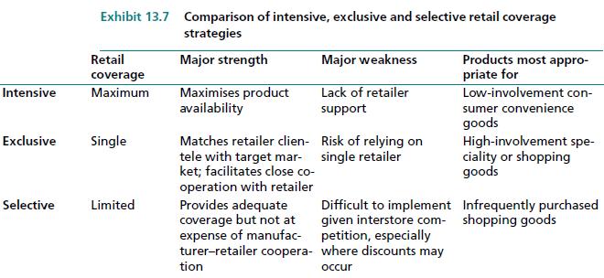
Retail Coverage Strategies

Slide 16
Market Entry Strategies
Exporting is the simplest way to enter a foreign market because it involves the least commitment and risk. It can be direct or indirect. The latter relies on the expertise of domestic international middlemen:
export merchants, who buy the product and sell it overseas for their own account;
export agents, who sell on a commission basis; and
cooperative organisations, which export for several producers, especially those selling farm products. Direct exporting uses foreign-based distributors/ agents or operating units (branches or subsidiaries) set up in the foreign country.

Slide 17
Market Entry Strategies
Contractual entry modes are nonequity arrangements that involve the transfer of technology and/or skills to an entity in a foreign country.
In licensing, a firm offers the right to use its intangible assets (technology, know-how, patents, company name, trademarks) in exchange for royalties or some other form of payment. Licensing is less flexible and provides less control than exporting. Further, if the contract is terminated, the licensor may have developed a competitor. It is appropriate, however, when the market is unstable or difficult to penetrate.
Franchising grants the right to use the company’s name, trademarks, and technology. Also, the franchisee typically receives help in setting up the franchise. It is an especially attractive way for service firms to penetrate foreign markets at low cost and to couple their skills with local knowledge and entrepreneurial spirit. Host countries are reasonably receptive to this type of exporting since it involves local ownership.

Slide 18
Market Entry Strategies
Other contractual entry modes include contract manufacturing, which involves sourcing a product from a manufacturer located in a foreign country for sale there or elsewhere (auto parts, clothes, and furniture). Contract manufacturing is most attractive when the local market is too small to warrant making an investment, export entry is blocked, and a quality licensee is not available.
A turnkey construction contract requires the contractor to have the project up and operating before releasing it to the owner. Coproduction involves a company’s providing technical know-how and components in return for a share of the output, which it must sell.
Countertrade transactions include barter (direct exchange of goods – hams for aircraft), compensation packages (cash and local goods), counter purchase (delayed sale of bartered goods to enable the local sold are used to produce other goods.

Slide 19
Market Entry Strategies
Overseas direct investment can be implemented in two ways – through joint ventures or sole ownership. Joint ventures involve a joint ownership arrangement to produce and/or market goods in a foreign country. Today, joint ventures are common because they avoid quotas and import taxes and satisfy government demands to produce locally. They also have the advantage of sharing investment costs and gaining local marketing expertise. For example, Motorola had difficulty penetrating the Japanese market until it formed an alliance with Toshiba to set up a joint chip-making venture. In addition, Toshiba provided Motorola with marketing help.
A sole ownership investment entry strategy involves setting up a production facility in a foreign country. Direct investment usually allows the parent organisation to retain total control of the overseas operation and avoids the problems of shared management and loss of flexibility.

